Slide 1

RDFox Advanced Reasoning Workshop
Tom Vout
Knowledge Engineer
Tom.vout@oxfordsemantic.tech

Slide 2
Objectives
The Intro
How to participate
Starting RDFox
Reasoning foundations & terminology
The Datalog Toolbox
Object & Datatype Properties
Domain & Range
Sub & Inverse Properties
Symmetry & Transitivity
Property Chains
Class Equivalence
Unions & Intersections
Importing axioms
Datalog Reasoning
Basic rules
Filters
Aggregates
Negation
Binds
Incremental Reasoning
Materialization vs. query rewriting
RDFox in enterprise
Please feel free to ask questions at any time!
You may want to reference the RDFox docs throughout.
Find them here: https://docs.oxfordsemantic.tech/

Slide 3




Additional information
Visit our website
Our blog
https://www.oxfordsemantic.tech
https://www.oxfordsemantic.tech/blog
Read our documentation
Request an evaluation license
https://docs.oxfordsemantic.tech/index.html
https://www.oxfordsemantic.tech/free-trial

Slide 4
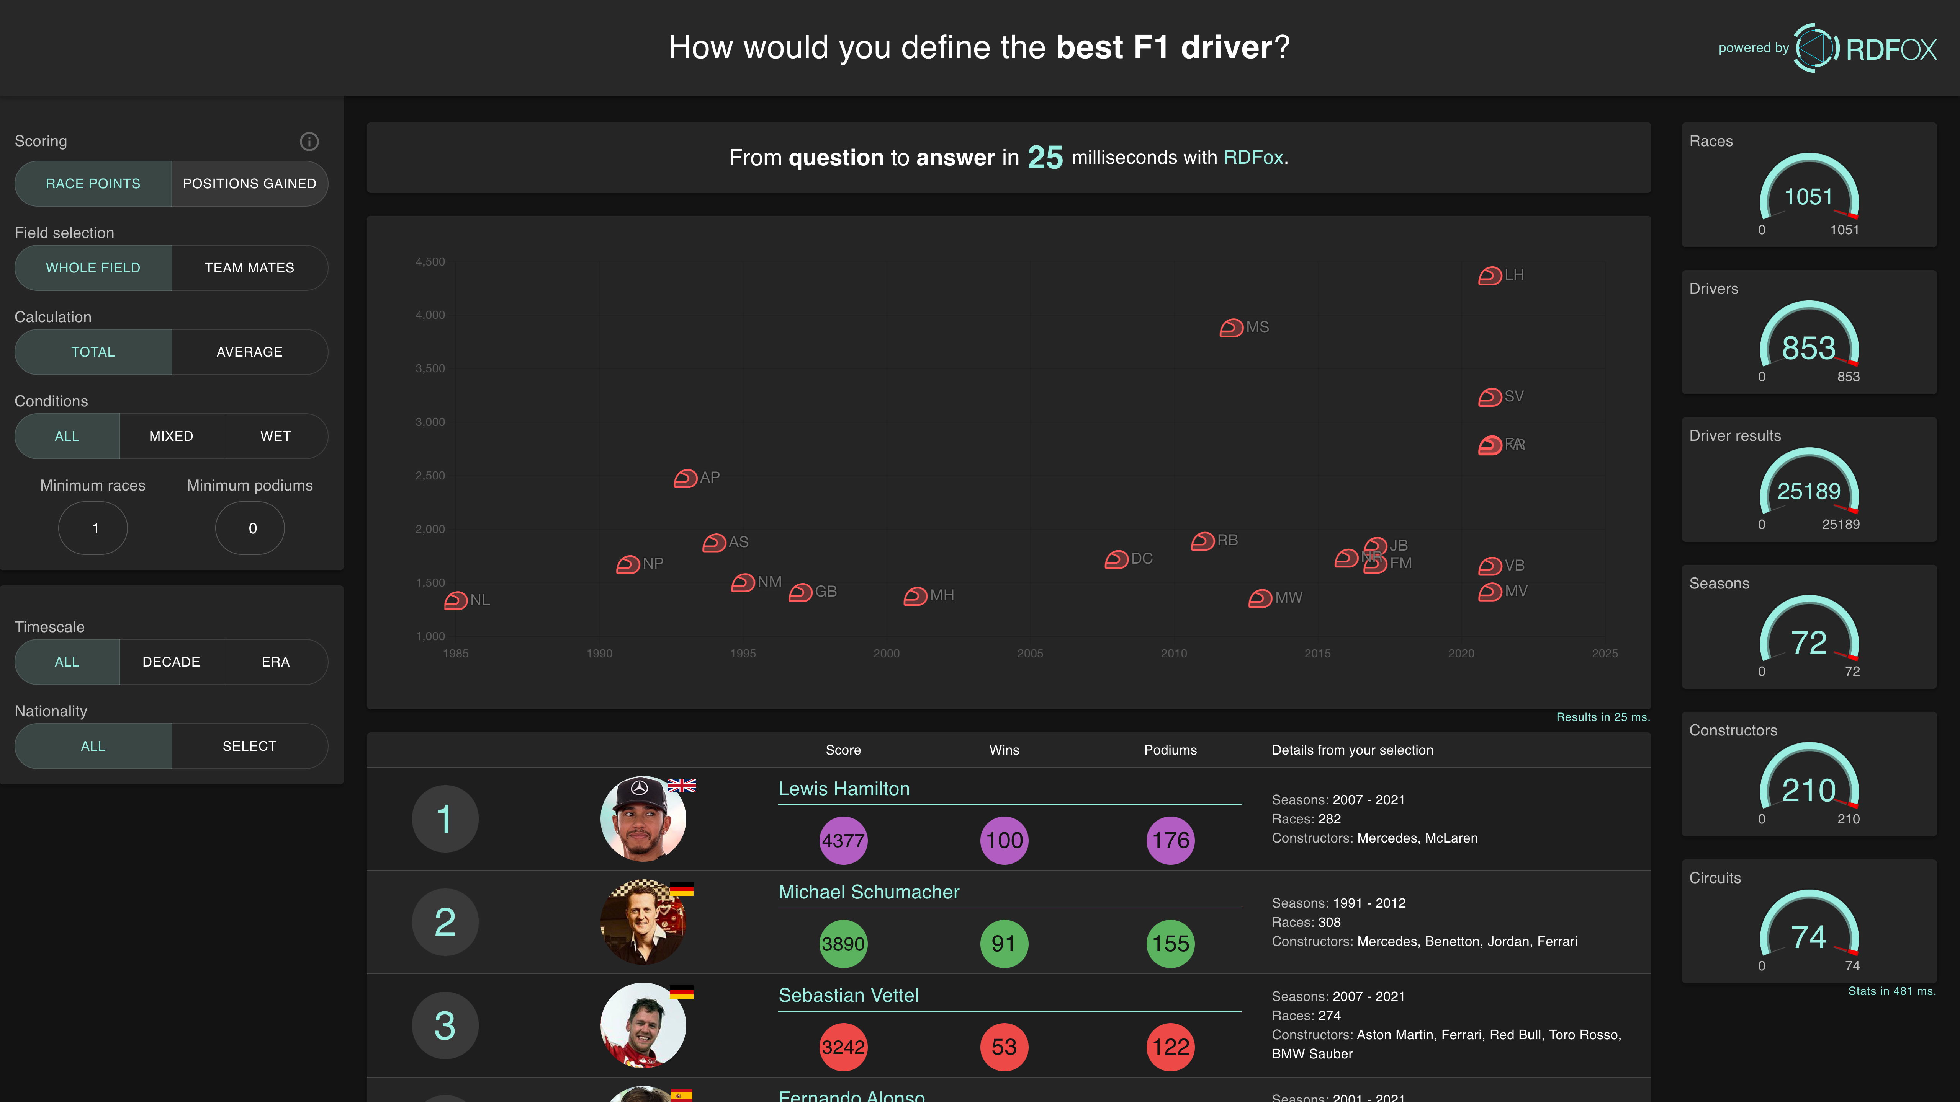
F1 Dashboard with Knowledge Graphs
Statistics about the data used
to form the results.
This matches the filters.
Controls and filters for the scoring system.
Try it for yourself!
http://f1.rdfox.tech

Slide 5





Objectives
By the end of the class everyone will:
Know how to write OWL axioms in Turtle syntax
Understand how RDFox performs reasoning
Know how to add OWL axioms to RDFox datastores
Know common uses of rules
Know how to write and import Datalog rules

Slide 6
Objectives
The Foundations
What is Semantic Reasoning?
What is RDFox?
Setting up RDFox
OWL Reasoning
Object & Datatype Properties
Domain & Range
Sub & Inverse Properties
Symmetry & Transitivity
Property Chains
Class Equivalence
Unions & Intersections
Importing axioms
Datalog Reasoning
Basic rules
Filters
Aggregates
Negation
Binds
Incremental Reasoning
Materialization vs. query rewriting
RDFox in enterprise
Please feel free to ask questions at any time! Exercises are scattered throughout. Links are provided for reference.
https://docs.oxfordsemantic.tech/

Slide 7
Objectives
The Foundations
What is Semantic Reasoning?
What is RDFox?
Setting up RDFox
OWL Reasoning
Object & Datatype Properties
Domain & Range
Sub & Inverse Properties
Symmetry & Transitivity
Property Chains
Class Equivalence
Unions & Intersections
Importing axioms
Datalog Reasoning
Basic rules
Filters
Aggregates
Negation
Binds
Incremental Reasoning
Materialization vs. query rewriting
RDFox in enterprise

Slide 8



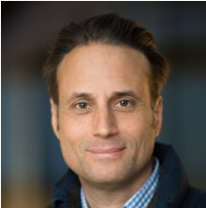


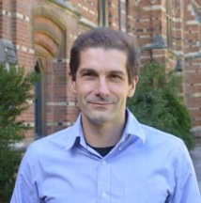
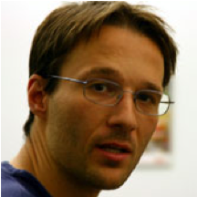

What is Semantic Reasoning?
Semantic Reasoning (rules-based AI) enriches a Knowledge Graph by adding new information
Rule:
Count the number of founders
5
has # of Founders
This combines knowledge and data to answer more complex questions beyond queries alone
has Founder
has Founder
OST
It drastically improves performance of queries by doing the hard work ahead of time
has Founder
has Founder
has Founder
Incremental Reasoning updates automatically with new data

Slide 9
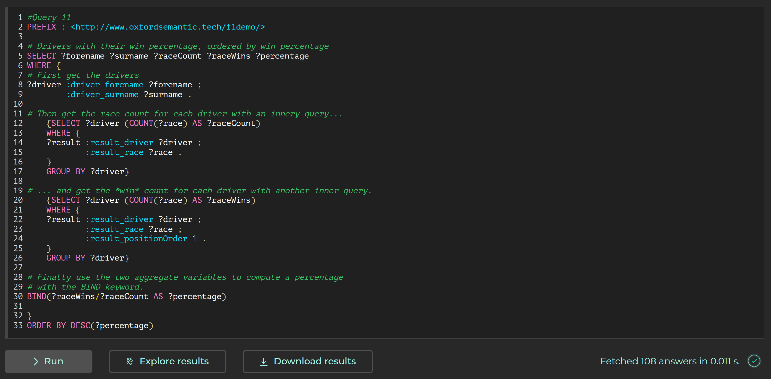
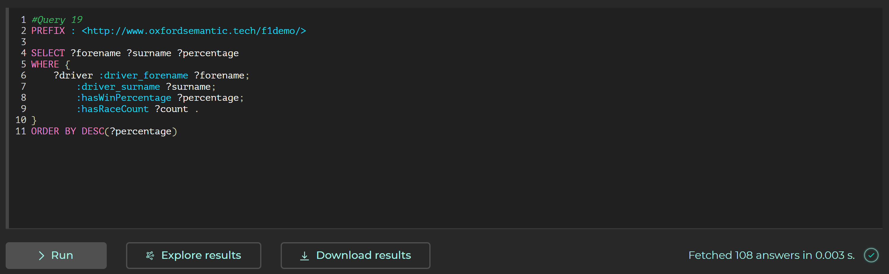
What can Reasoning do for you?
Datalog
rules

Slide 10



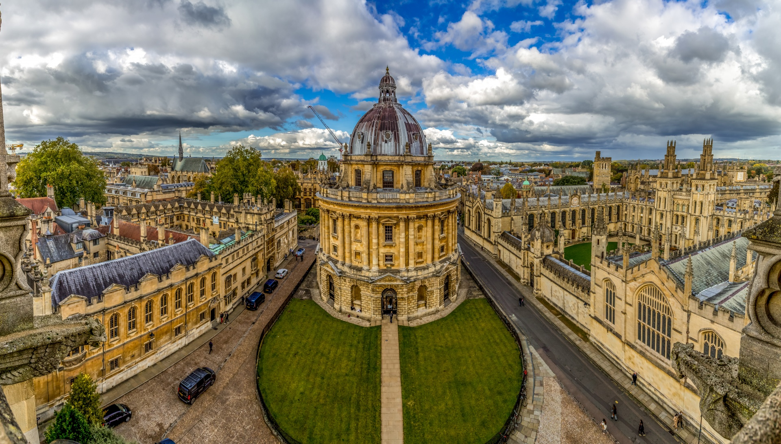
What is RDFox®?
RDFox is a Knowledge Graph database
and Semantic Reasoning Engine
Incremental Semantic Reasoning
Speed & Scalability
On Device
Oxford University

Slide 11



Requirements
A.
Get an RDFox License
B.
Download RDFox (& unzip)
C.
Download the class materials from Github
D.
Get your IDE of choice ready
(VS Code recommended)
https://www.oxfordsemantic.tech/free-trial
https://www.oxfordsemantic.tech/downloads
https://github.com/OxfordSemantic/RDFoxWorkshop
https://code.visualstudio.com

Slide 12
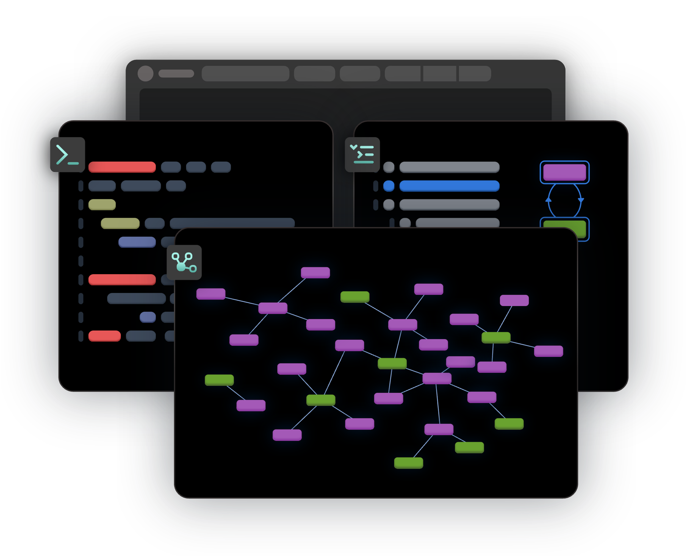
Setting up RDFox
Start RDFox
Create a data store
Load the data

Slide 13
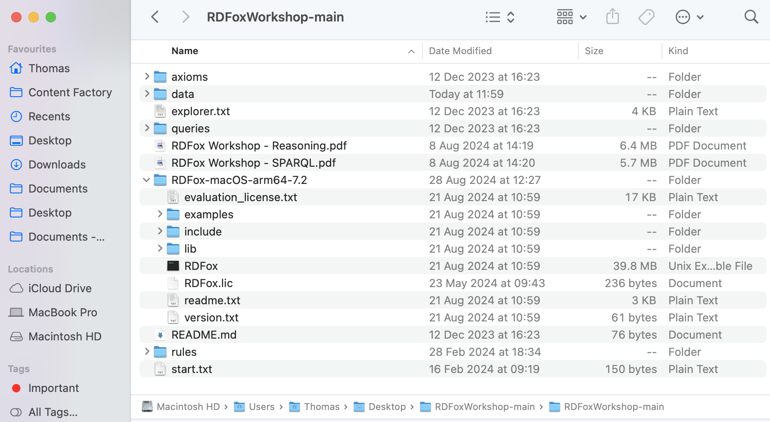
Organizing your files
1.
Make sure to put your RDFox folder INSIDE the RDFox Workshop folder
Your workshop folder will be called ‘RDFoxWorkshop’ if you cloned it (rather than downloading it)
2.
Then drop your RDFox license INSIDE the RDFox folder
Without this setup you will need to use different file paths in the commands we provide.

Slide 14


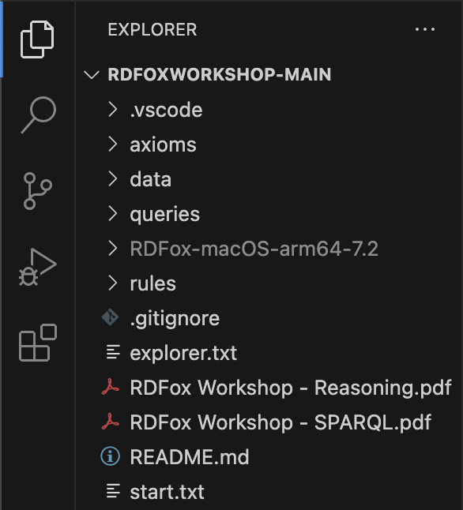
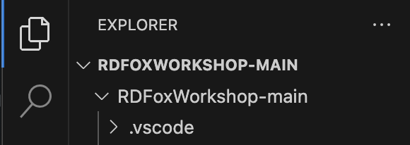
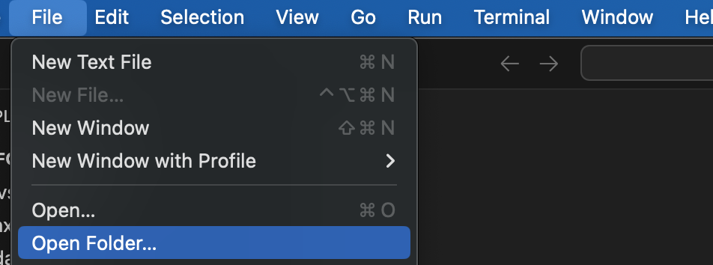

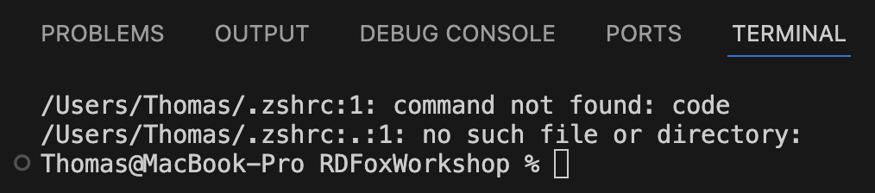
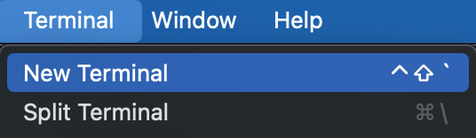
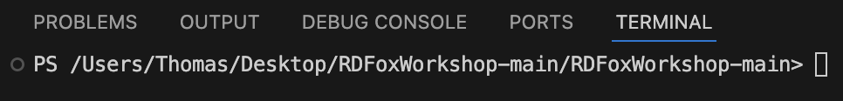
Opening the terminal in VS Code
Open VS Code
Open the workshop folder with
File > Open Folder
Select the folder directly containing the ‘data’, ‘rules’, ‘queries’ folders etc.
If the folder name appears twice, repeat step 2 and open the inner-most folder
Open a new terminal with
Terminal > New Terminal
› E.g. MacOS (zsh)
› E.g. Windows (PowerShell)
This path is unique to you

Slide 15
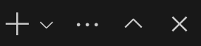
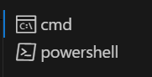
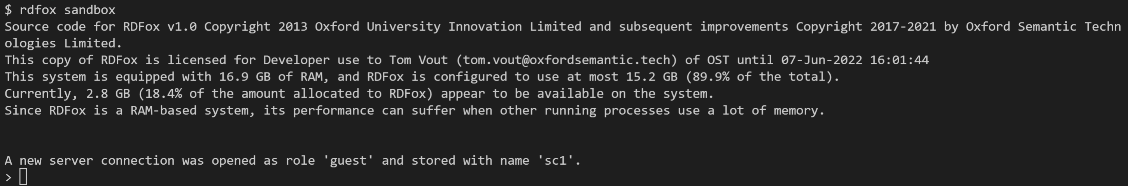
Starting RDFox
In the terminal, from the ‘RDFox Workshop’ working directory,
run the relevant command for the version of RDFox you downloaded:
You will need to edit the command if you are not using RDFox v7.2 or are running on LINUX
› MacOS ARM
./RDFox-macOS-arm64-7.2/RDFox sandbox
› MacOS INTEL
./RDFox-macOS-x86_64-7.2/RDFox sandbox
The Windows command depends on the shell used – shown right of the terminal window
› Windows (CMD)
RDFox-win64-x86_64-7.2\RDFox.exe sandbox
› Windows (PowerShell)
& RDFox-win64-x86_64-7.2\RDFox sandbox
The RDFox server should now be running!
If not, see next slide for common fixes

Slide 16
Common fixes
File path needs quotes and/or backslash
All systems
command not found
is not recognised
permission denied
is a directory
Problem: Some terminals handle slashes and special characters differently
Fix: Surround the file path (excluding ‘sandbox’) with quotation marks ”” and, on Windows, replace forward-slashes ‘/’ with back-slashes ‘\’
Unzipping creates a nested folder
Predominantly Windows
The system cannot find the path specified.
The term is not recognized
Problem: Unzipping a folder sometimes puts the contents in a folder of its own name
Fix: Use the inner ‘RDFoxWorkshop’ as the working directory (open VS code at the inner folder)
Check your folder structure
All systems
Ensure your folder structure follows RDFoxWorkshop > RDFox-macOS-arm64-7.2 > RDFox.lic
Check your working directory and spelling
All systems
Ensure your terminal is running from the RDFoxWorkshop folder and your commands are correct
If you are still encountering issues, please raise your hand

Slide 17

Loading Data into RDFox
First we need to create a data store…
dstore create f1
Then to set it as active.
Everyone, include those who have just completed the SPARQL intro, need to do this step.
active f1
Now import the race data up to the year 2020
import +p data/upTo2020.ttl

Slide 18
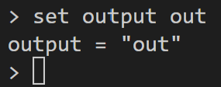

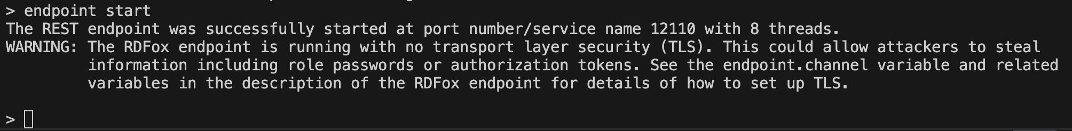
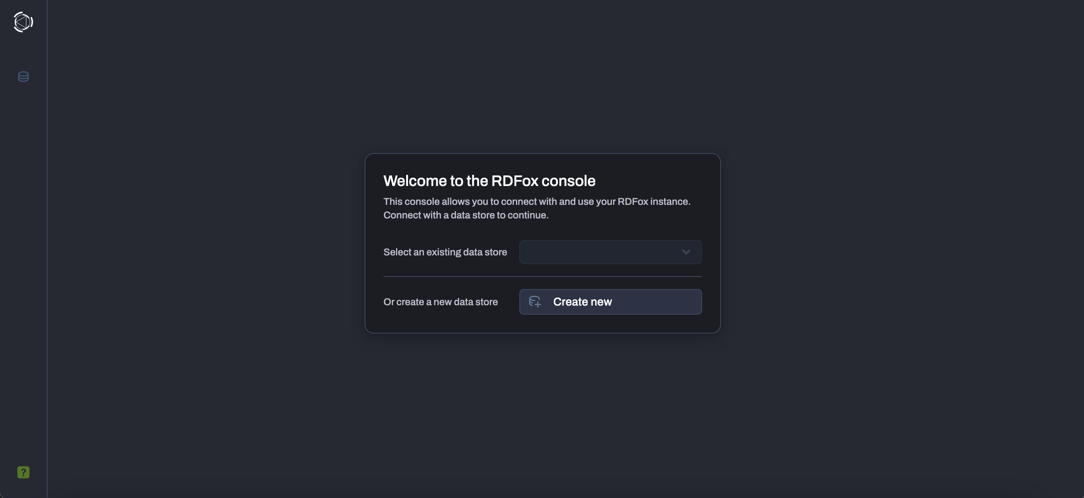
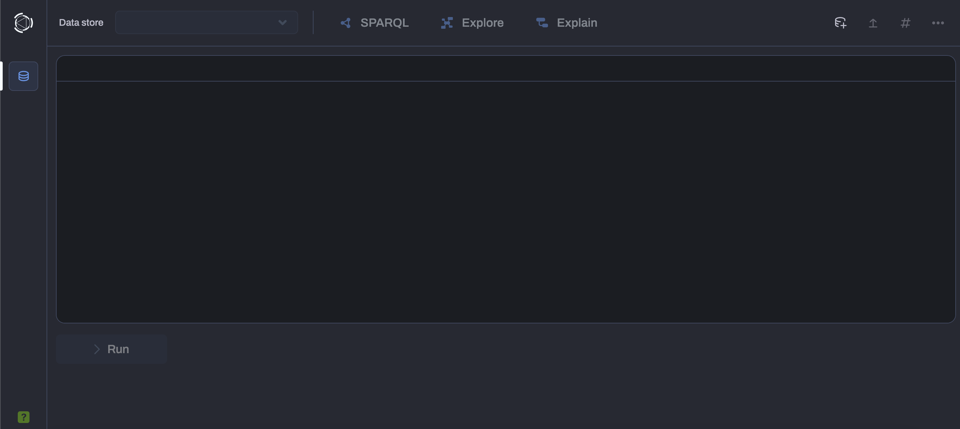
Setting the output
In the Web Console and the shell
To see the output in the shell:
set output out
You will only need to use the shell in this tutorial.
To use the Web Console:
In the terminal, run:
endpoint start
Open a browser and go to:
localhost:12110/console
This will show an empty console

Slide 19
Objectives
The Foundations
What is Semantic Reasoning?
What is RDFox?
Setting up RDFox
OWL Reasoning
Object & Datatype Properties
Domain & Range
Sub & Inverse Properties
Symmetry & Transitivity
Property Chains
Class Equivalence
Unions & Intersections
Importing axioms
Datalog Reasoning
Basic rules
Filters
Aggregates
Negation
Binds
Incremental Reasoning
Materialization vs. query rewriting
RDFox in enterprise

Slide 20
OWL Reasoning
Object & Datatype Properties
Sub Properties
Domain & Range
Inverse Properties
Symmetry & Transitivity
Property Chains
Class Equivalence
Unions
Class Intersections
Importing axioms

Slide 21
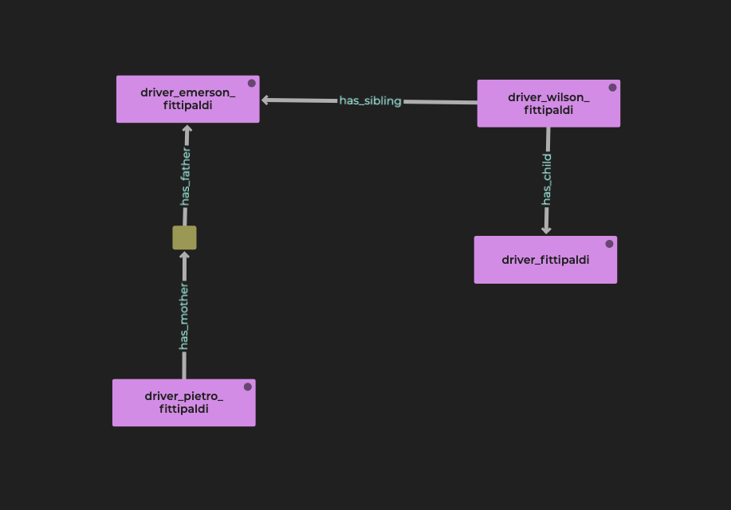
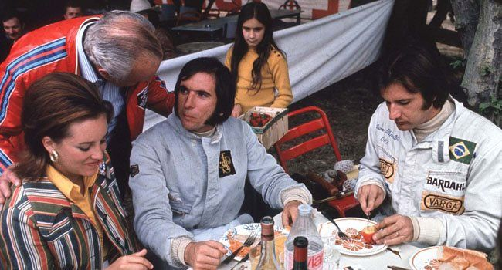
Meet the Fittipaldis
Data is often irregular
Is there something that can help us make it regular?
As it happens, there is…

Slide 22
Web Ontology Language (OWL)
Standard created by W3C, RDFox supports the profile OWL 2 RL
Axioms are assertions about classes, properties or individuals
Ontology are collection of axioms
Ontologies are themselves graphs and can be written in many different syntaxes – we will use Turtle

Slide 23

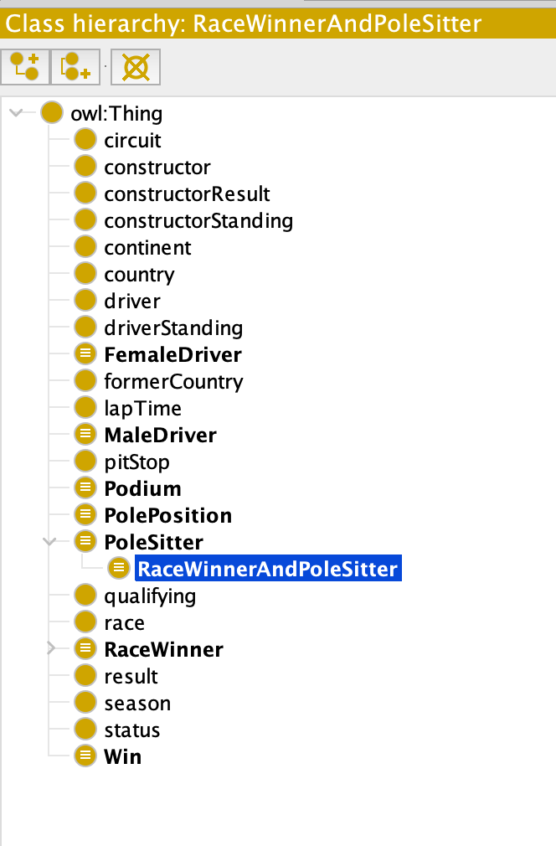
Useful program for managing ontologies
Free and open source
Before writing an ontology, it is often better to have some data first and to consider the queries you want to facilitate

Slide 24
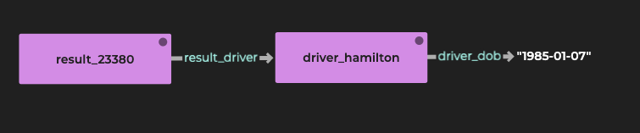
Axiom Set 1
Object & Datatype Properties
Predicates have two different types.
The subject of any predicate is always a node.
:result_driver rdf:type owl:ObjectProperty .
:driver_dob rdf:type owl:DatatypeProperty .
Predicates that are Object Properties always connect a node to another node.
Predicates that are Datatype Properties always connect a node to a literal.
rdf:type is longhand for the ‘a’ keyword we’ve seen in SPARQL .
Here, we’re providing information about predicates.

Slide 25
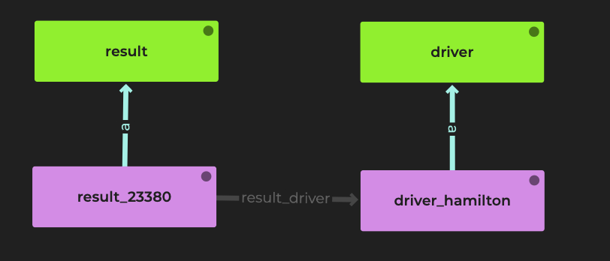
Axiom Set 2
Domain & Range
We can infer information about the subject and object nodes of a given relationship.
The domain of a predicate is the group of nodes that exist in its subject position.
:result_driver rdf:type owl:ObjectProperty ;
rdfs:domain :result ;
rdfs:range :driver .
The range of a predicate is the group of nodes that exist in its object position.
By design, the predicate ‘result_driver’ will always connect an instance of a Result (domain) to an instance of a Driver (range).
Axioms do not validate the data, only add new information.
RDFox supports data validation with SHACL and Datalog but it is beyond the scope of this workshop. Get in to learn more.

Slide 26
Axiom Set 2
Domain & Range
We can infer information about the subject and object nodes of a given relationship.
The domain of a predicate is the group of nodes that exist in its subject position.
:result_driver rdf:type owl:ObjectProperty ;
rdfs:domain :result ;
rdfs:range :driver .
By design, ‘result_driver’ will always connect an instance of a Result to an instance of a Driver.
As in SPARQL, the first entry can be shared across multiple lines, with a ‘;’.
Axioms do not validate the data, only add new information.
RDFox supports data validation with SHACL and Datalog but it is beyond the scope of this workshop. Get in to learn more.
The range of a predicate is the group of nodes that exist in its object position.

Slide 27
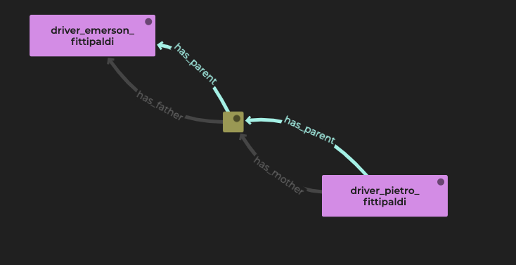
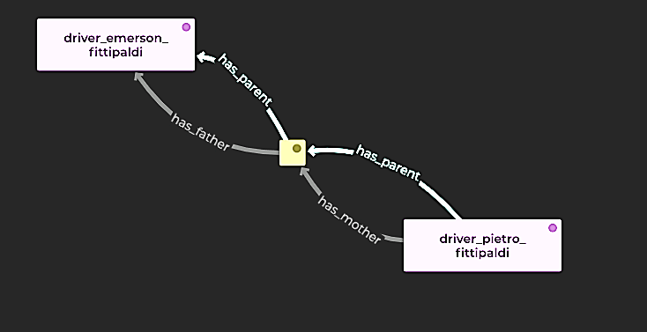
Axiom Set 3
Sub Properties
‘Father’ and ‘mother’ relationships are sub-properties of ‘parent’.
:has_father a owl:ObjectProperty ;
rdfs:subPropertyOf :has_parent .
:has_mother a owl:ObjectProperty ;
rdfs:subPropertyOf :has_parent .
‘:has_parent’ will be added between all nodes that share the ‘:has_father’ relationship.
Multiple axioms can refer to the same properties.
‘:has_parent’ will also be inferred wherever nodes share ‘:has_mother’.

Slide 28
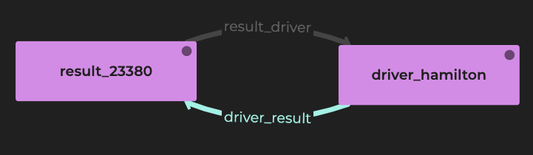
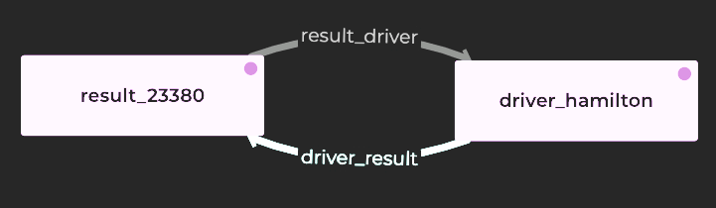
Axiom Set 4
Inverse Properties
result_driver is the opposite of driver_result.
:result_driver rdf:type owl:ObjectProperty ;
owl:inverseOf :driver_result .
Only Object Properties can have inverse relationships as the subject of a triple must always be a node.
‘:driver_result will be inferred between nodes that share the ‘:result_driver relationship in the opposite direction, swapping around the subject and object nodes.

Slide 29
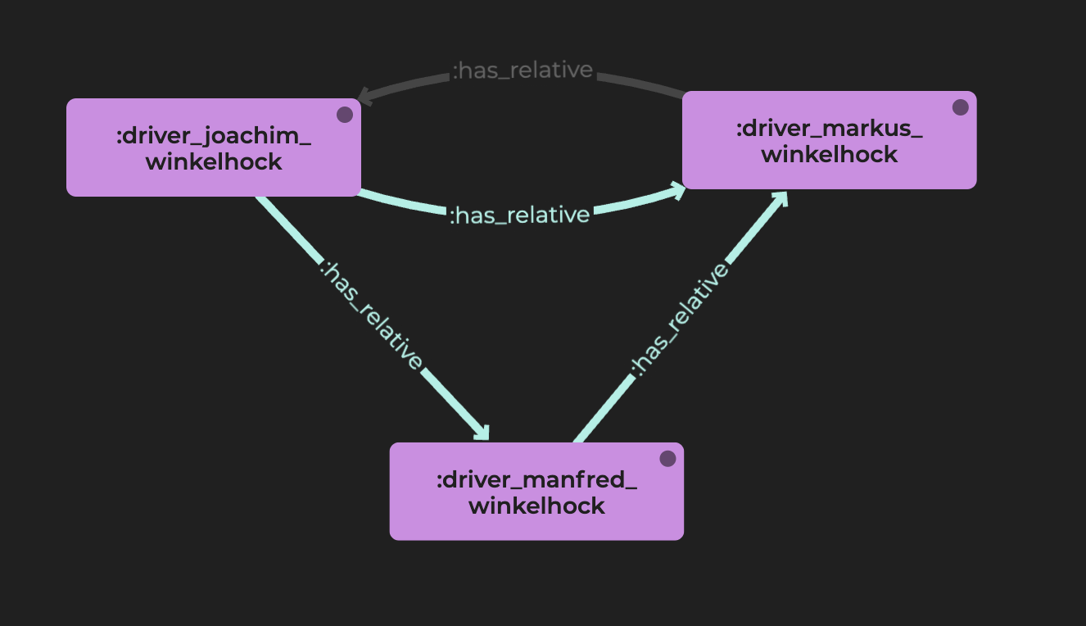
Axiom Set 5
Symmetry & Transitivity
Family relatives share the same relationships in many ways.
:has_relative a owl:ObjectProperty ,
owl:TransitiveProperty ,
owl:SymmetricProperty .
As in SPARQL, the first and second entries can be shared across multiple lines, with a ‘,’.
Transitive Properties are inferred between nodes that are indirectly connected via a chain of that property.
The same fact can be derived in multiple ways.
RDFox will handle duplicates and only include one.
Symmetric Properties are inferred in both directions between a pair of nodes.
Some edges have been hidden from this diagram for clarity.

Slide 30
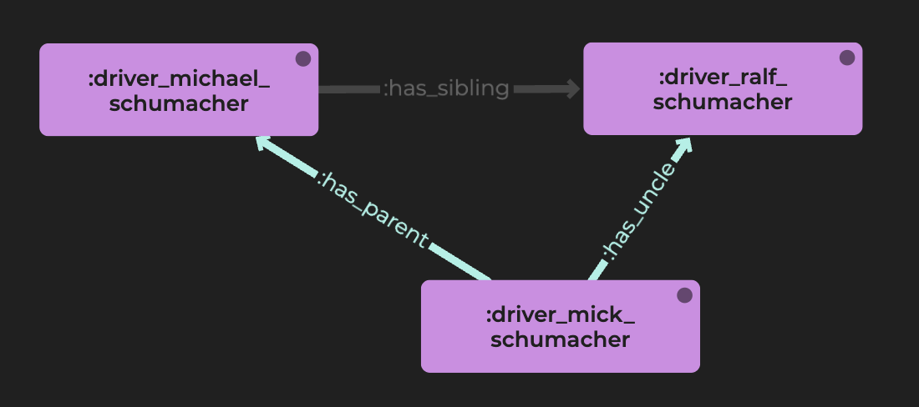
Axiom Set 6
Property Chains
An Uncle is a parent’s sibling …in this male-only dataset.
It can be useful to directly connect nodes that are connected indirectly by other nodes and a chain of properties.
:has_uncle a owl:ObjectProperty ;
owl:propertyChainAxiom (
:has_parent
:has_sibling
).
The predicates in a Property Chain are given as lists using ‘()’.
If Alice has a parent Bob, and Bob has a sibling Charlie, then it will be inferred that Charlie is Alice’s Uncle.

Slide 31
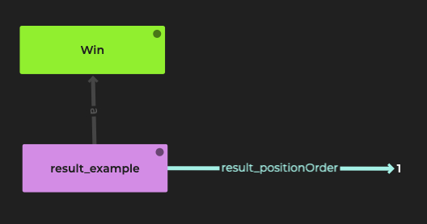
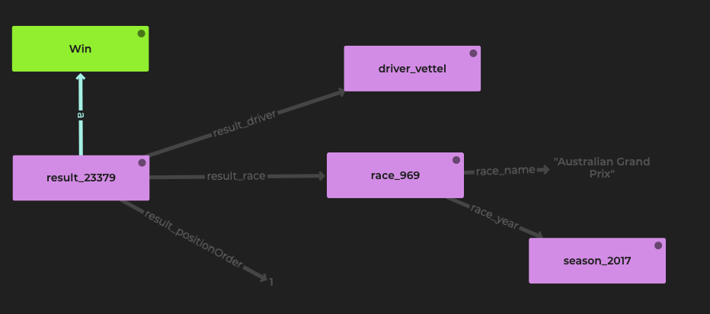
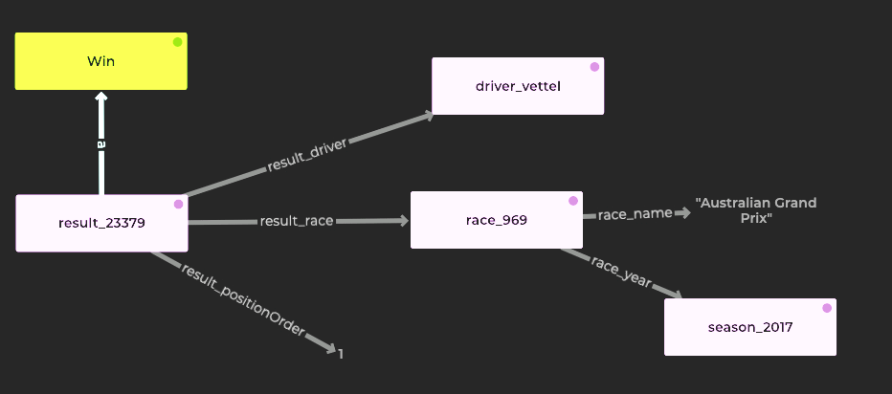
Axiom Set 7
Class Equivalence
Ensuring every first-place finish is classed as a win.
Classes are often groups of things that share common properties.
Having those properties is equivalent to being in that class, and vice versa.
:Win a owl:Class ;
owl:equivalentClass
[
a owl:Restriction ;
owl:onProperty :result_positionOrder ;
owl:hasValue "1"^^xsd:integer
] .
For any class, an equivalent class can either be another class or a node that has certain properties.
Using square brackets ‘[]’, we define a blank node that represents all things with a restriction that it has the property ‘:result_positionOrder’ with a value of 1.

Slide 32
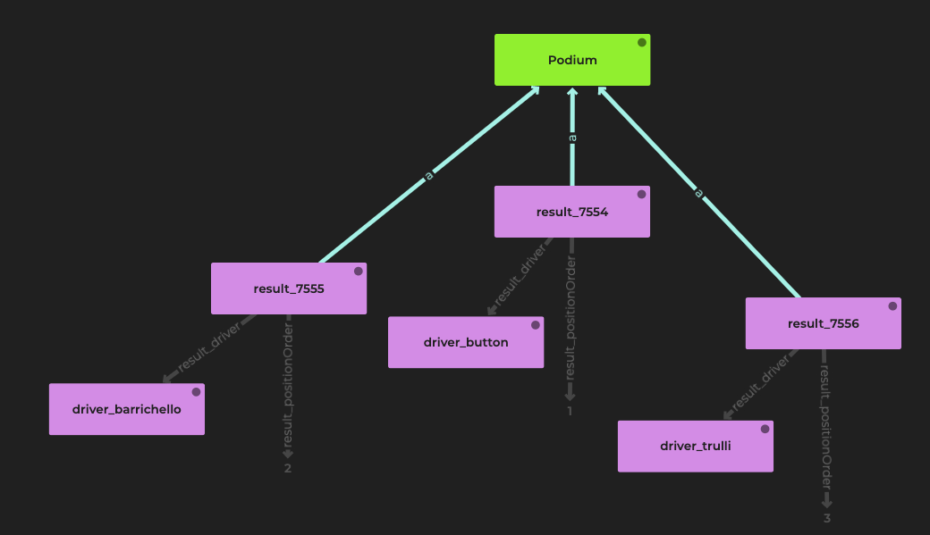
Axiom Set 8
Unions
Accepting one thing OR another.
:Podium a owl:Class ;
owl:equivalentClass [
a owl:Class ;
owl:unionOf (
[
a owl:Restriction ;
owl:onProperty :result_positionOrder ;
owl:hasValue "1"^^xsd:integer
]
[
a owl:Restriction ;
owl:onProperty :result_positionOrder ;
owl:hasValue "2"^^xsd:integer
]
[
a owl:Restriction ;
owl:onProperty :result_positionOrder ;
owl:hasValue "3"^^xsd:integer
]
)
] .
By using owl:unionOf we can accept several patterns.
In F1, a ‘Podium’ means finishing 1st, 2nd, or 3rd.
We can combine both lists ‘()’ and blank nodes ‘[]’.

Slide 33
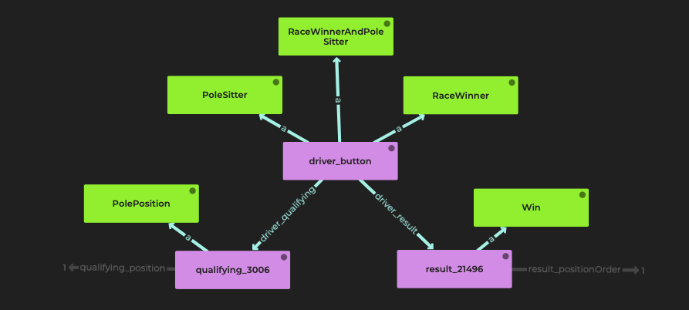
Axiom Set 9
Class Intersections
Combining one thing AND another.
:RaceWinnerAndPoleSitter
a owl:Class ;
owl:equivalentClass [
a owl:Class ;
owl:intersectionOf (
:RaceWinner
:PoleSitter
)
] .
Everything inside owl:intersectionOf must be included in the matched pattern.

Slide 34
Parsing the Ontology
Now we just need to import the axioms into a named graph, and then parse the graph for axioms:
import > :myAxioms axioms/axioms.ttl
importaxioms :myAxioms

Slide 35
OWL 2 RL Limitations
The RL fragment of OWL has some limitations
It does not support existentials
This is why we see some warning when parsing the axioms
When asserting that a result is a podium, we have no way of knowing whether it’s a P1, P2, or P3.
Similarly, when declaring a race winner, we have no way of knowing which result of theirs is a win.

Slide 36
Removing Axioms
We will replace these axioms with Datalog rules, so we first need to remove them from out data store:
importaxioms :myAxioms -
update ! Clear graph :myAxioms

Slide 37
Objectives
The Foundations
What is Semantic Reasoning?
What is RDFox?
Setting up RDFox
OWL Reasoning
Object & Datatype Properties
Domain & Range
Sub & Inverse Properties
Symmetry & Transitivity
Property Chains
Class Equivalence
Unions & Intersections
Importing axioms
Datalog Reasoning
Basic rules
Filters
Aggregates
Negation
Binds
Incremental Reasoning
Materialization vs. query rewriting
RDFox in enterprise

Slide 38
Datalog Reasoning with RDFox
Basic rules
Filters
Aggregates
Negation
Binds
Incremental reasoning
Materialization vs. query rewriting
RDFox in enterprise

Slide 39
Datalog Rules
[ fact A] :- [ fact B]​ .
“A is true whenever B is true”

Slide 40
Rule 1
Basic rules
[?driver, :hasRacedIn, ?race] :-
[?result, :result_race, ?race],
[?result, :result_driver, ?driver] .
This rule will add a direct link between drivers and the races they raced in. Notice this has the same effect as axiom 4, but expressed more clearly.
import rules/r1.dlog
The same could seemingly be achieved with an equivalent SPARQL update, but rules offer several advantages over write queries.
Check for inferred triples with query 14 – q14.rq
evaluate queries/q14.rq

Slide 41
Rule 2
Filters
[?driver, :hasPodiumInRace, ?race] :-
[?result, :result_race, ?race],
[?result, :result_driver, ?driver],
[?result, :result_positionOrder, ?positionOrder],
FILTER(?positionOrder < 4) .
We can use FILTERs in rules too, in this case to find the races in which a driver reached the podium.
import rules/r2.dlog
Check for inferred triples with query 15 – q15.rq
evaluate queries/q15.rq

Slide 42
Rule 3
Aggregates
[?driver, :hasRaceCount, ?raceCount] :-
AGGREGATE(
[?driver, :hasRacedIn, ?race]
ON ?driver
BIND COUNT(?race) AS ?raceCount
) .
This rule adds a count of races a driver has entered.
Notice we use the previously inferred :hasRacedIn property. Rules can be composed together, and RDFox will automatically find the order in which to run them.
import rules/r3.dlog
Check for inferred triples with query 16 – q16.rq
evaluate queries/q16.rq

Slide 43
Rule 4 - Exercise
Aggregates
[?___, :hasRaceWinCount, ?___] :-
AGGREGATE(
[?___, :result_driver, ?___],
[?___, :result_positionOrder, 1] # Make sure the driver actually won
ON ?driver
BIND COUNT(?___) AS ?___
) .
This rule adds a count of races a driver has won (provided they won at least 1). We can put more than on atom inside the AGGREGATE statement.
import rules/r4.dlog
Check for inferred triples with query 17 – q17.rq
evaluate queries/q17.rq

Slide 44
Rule 5
Negation
[?driver, a, :DriverWithoutPodiums] :-
[?driver, a, :driver],
NOT EXISTS ?race IN (
[?driver, :hasPodiumInRace, ?race]
) .
This rule tells us that if a driver does not have a race where they were on the podium, then they are a :DriverWithoutPodiums.
So, we are looking for something that is not in the data (i.e. no race where the driver was on the podium).
import rules/r5.dlog
Check for inferred triples with query 18 – q18.rq
evaluate queries/q16.rq

Slide 45
Negation as Failure
Negation as failure is negation understood as the absence of a triple. Using Negation as Failure leads to ‘non-monotonic reasoning’- the engine may need to retract some triples instead of just adding them. This adds another dimension to an already complicated problem of reasoning planning, but RDFox handles all of that automatically.
Example
What if a driver without any podiums so far gets a podium next year? In 2021, for instance, George Russell got his first podium. In our data, which is accurate up to and including 2020, George Russell would be a :DriverWithoutPodiums. But if we add data from 2021, we will need to retract this fact.
Exercise
Run the query ”q18_1.rq”, then import the data from file “2021-23.ttl” and try again
evaluate queries/q18_1.rq

Slide 46
Rule 6 - Exercise
Binds
[?driver, :hasWinPercentage, ?percentage] :-
[?___, :hasRaceCount, ?___],
[?___, :hasRaceWinCount, ?___],
BIND(?raceWinCount/?raceCount AS ?percentage) .
With BIND we can use various mathematical functions, string manipulation, regular expression matching, conditional binds, hashing and IRI creation.
import rules/r6.dlog
Check for inferred triples with query 19 – q19.rq
evaluate queries/q19.rq

Slide 47
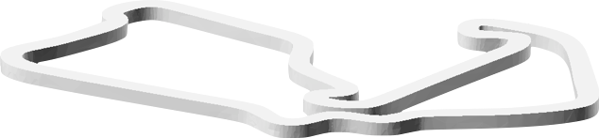
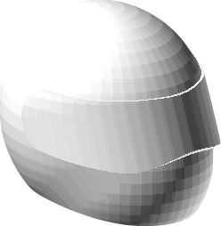

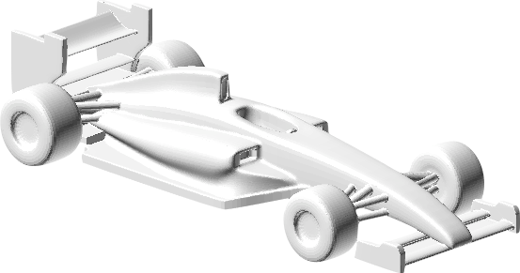
Bonus Exercise
race
race
driver
race
driver
Driver 1
Result 1
constructor
Result 2
Driver 2
constructor
constructor
hasTeammate
hasTeammate
Write and import a rule to find out if two drivers have been teammates (use the predicate :hasTeammate).

Slide 48
RDFox: How does it work?

Slide 49


Incremental Reasoning
Data can be imported at any time, and RDFox will automatically compute the necessary inferences.
This all happens incrementally, without the need to reboot.
Incremental reasoning open the door to many novel use cases which were previously impractical.
Incremental reasoning
RDF
Initial Load
Materialize
SYSTEM READY
Incremental Updates
Multi-threaded load importing multiple files in parallel
Materializes the knowledge base into the graph
Incremental updates to both data and rules
1950 - 2020
Highly scalable query engine
2021+
SPARQL

Slide 50

RDFox vs. other solutions
Feature | Example | RDFox | Materialisation Competitors | Query Rewriting Competitors
Ontological reasoning | List all financial instruments / derivative instruments / futures. (Class inferencing)
Graph analytics | What is the nearest electrical switch for a circuit? (Negation & Recursion)
Data analytics | What is the total volume and value of trades? (Aggregation & Arithmetic)
Local constraints validation | No trades over a limit & no traders without trades! (Filters & Negation) |  | Partial (SHACL)
Global constraint valudation | Every component must be connected to a power source! (Negation & Recursion)
All of the above | What is the total value of assets owned through holdings?
*
**
* many times slower than RDFox
** orders of magnitude slower than RDFox

Slide 51

RDFox : an enterprise solution
Highly scalable query engine
OWL
SWRL
SPARQL
RDF
RDFox
Datalog
Initial Load
Materialize
Incremental reasoning
Multi-threaded load importing multiple files in parallel
Materializes the knowledge base into the graph
SYSTEM READY
Incremental Updates
or
Access Control
ACID Transactions
Restart from persistent store
Load from disk based persistent store
Incremental updates to both data and rules
External Sources
Persistence
Constraints Validation
SQL
CSV
SHACL
Datalog
Solr
FTS

Slide 52








Deployment Options
Mobile & edge devices
Personal machines on premises to cloud

Slide 53






RDFox Architecture
END USER APPLICATIONS
3RD PARTY
VISUALISATIONS
ANALYTICS &
MACHINE LEARNING
INTEGRATION
IN-PROCESS
(EMEBEDDED)
DEVELOPMENT
& OPERATIONS
HTTP REST
External integration solutions
Web console
RDFox Explorer
HTTP
SPARQL
HTTP REST
RDF
Datastore admin
Query
Explorer
RDFox Explain
SPARQL API
Datalog
OWL
HTTP REST
Reasoning engine
Command line interface
Content endpoint API
Persistence
Datalog
OWL
SQL
CSV
HTTP REST
CSV FILE
SQL ODBC
SOLR HTTP
External Data Sources
High Availability
SHACL
SWRL
Solr
FTS
EDGE & MOBILE DEVICES
PERSONAL MACHINES,
ON PREMISES TO CLOUD

Slide 54
Objectives
The Foundations
What is Semantic Reasoning?
What is RDFox?
Setting up RDFox
OWL Reasoning
Object & Datatype Properties
Domain & Range
Sub & Inverse Properties
Symmetry & Transitivity
Property Chains
Class Equivalence
Unions & Intersections
Importing axioms
Datalog Reasoning
Basic rules
Filters
Aggregates
Negation
Binds
Incremental Reasoning
Materialization Vs. query rewriting
RDFox in enterprise

Slide 55
Your final exercise…
Click on the link below to start filling out our quick survey.
It won’t take you more than 3 minutes!
https://oxfordsemantictech.typeform.com/to/WuuNcFPm

